Slide 1
Sentiment Analyzer
By Divya Uppal
August 2022

Slide 2

What is sentiment Analyzer?
Analyses tweets associated with world leaders
Outputs Positive/Negative/Favourite/Most Retweeted Tweet
Output average sentiment associated
Displays word Cloud

Slide 3




Data Flow
Nosql Database on Cloud (Document oriented database)
Download data frame with sentiment as a csv
MongoDb
CSV
Twitter
AWS
Streamlit
Data is gathered for top leaders from Twitter using Tweepy API
Python code runs on AWS EC2 instance, it cleans tweets and do sentiment analysis
Create a web app to analyse tweeting pattern for different world leaders

Slide 4
Toolbox
Tweepy
(123K Tweets)
Streamlit
MongoDb (Cloud)
AWS

Slide 5
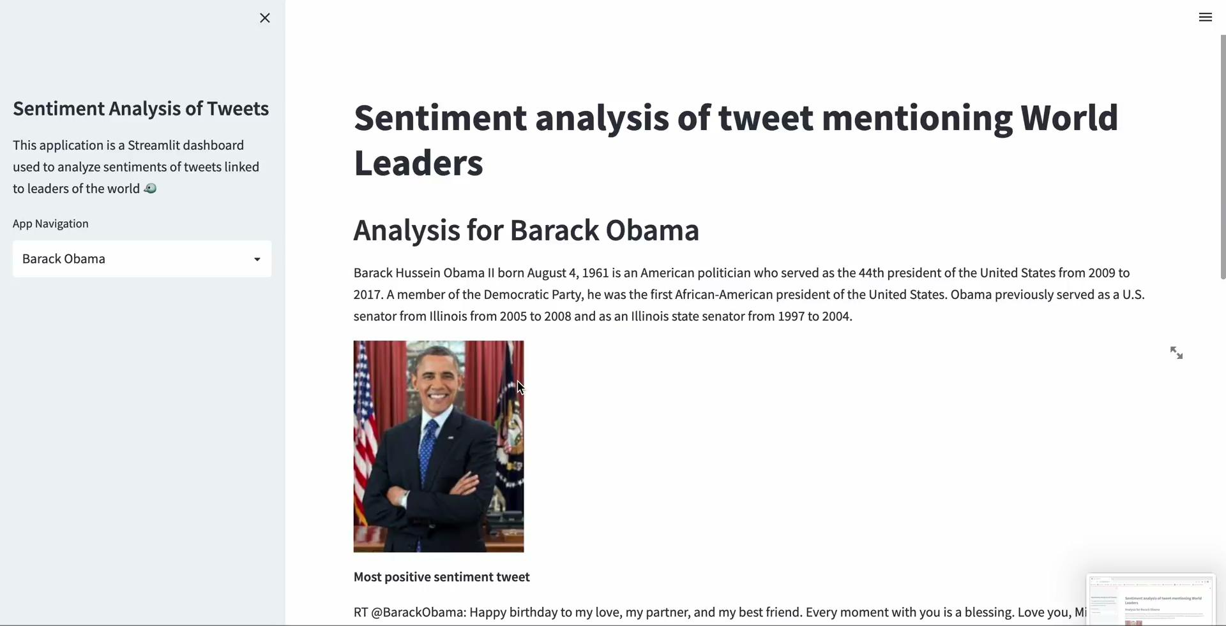
Product Demo

Slide 6
Future Scope
Real time collection of tweets
Gather data from multiple sources: Facebook, Instagram, News Article etc
Use Machine Learning based sentiment analysis model
Store final data frame on a relational database on cloud
Rigorous unit testing to capture edge cases
Launch web app on internet

Slide 7
Thank You..

